Slide 1
GRAPH TRAVERSAL

Slide 2
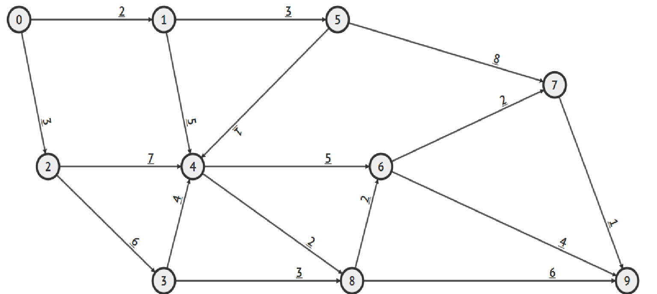
Example
Is there a path from 0 to 9? If there is, list one of them.

Slide 3
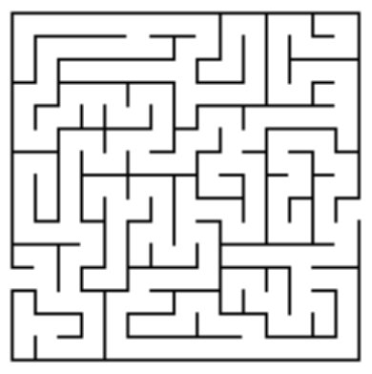
Maze Traversal Puzzle

Slide 4
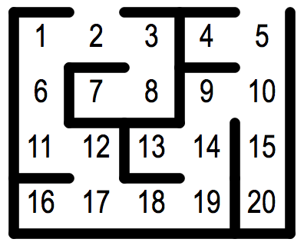
Maze Traversal

Slide 5
Graph Traversal
Graph traversal (also known as graph search) refers to the process of visiting (checking and/or updating) each vertex in a graph. Such traversals are classified by the order in which the vertices are visited

Slide 6

Friend of Friend Problem

Slide 7
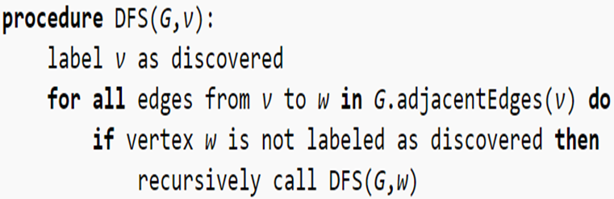
Depth First Search - DFS
A depth-first search (DFS) is an algorithm for traversing a finite graph. DFS visits the child vertices before visiting the sibling vertices; that is, it traverses the depth of any particular path before exploring its breadth. A stack (often the program's call stack via recursion) is generally used when implementing the algorithm.

Slide 8
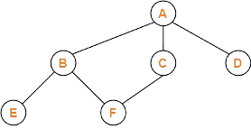

Slide 9
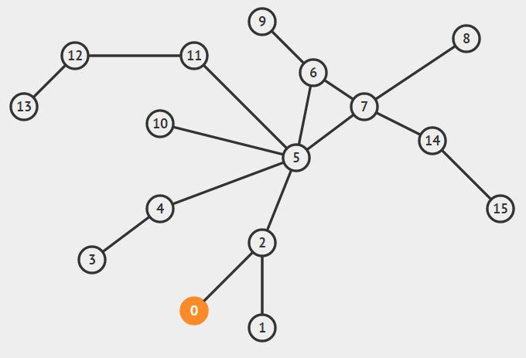
Depth First Search - DFS

Slide 10
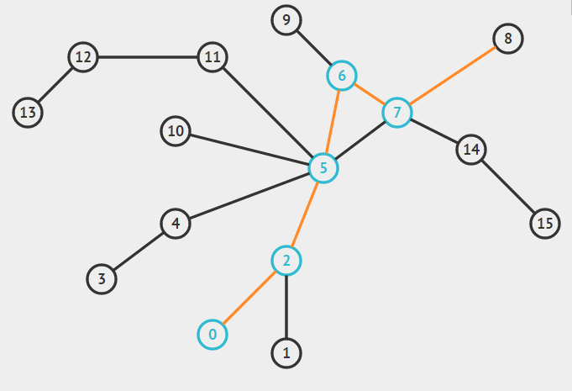
Depth First Search - DFS

Slide 11
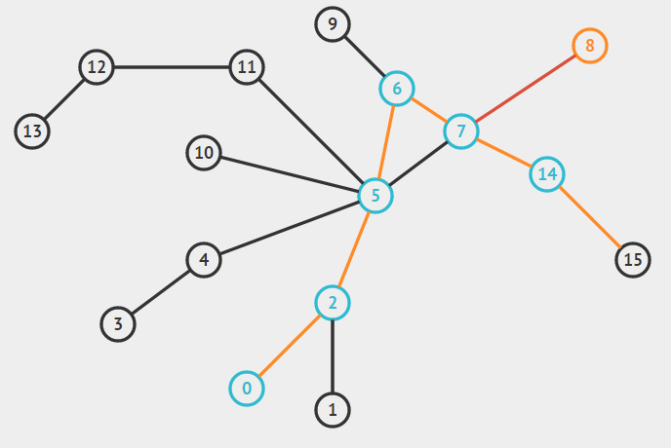
Depth First Search - DFS

Slide 12
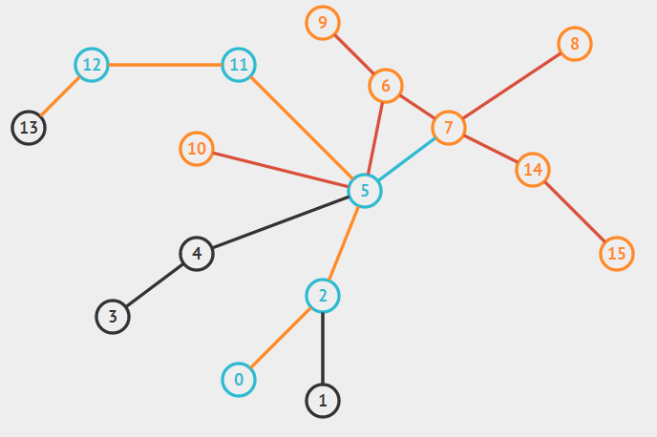
Depth First Search - DFS

Slide 13
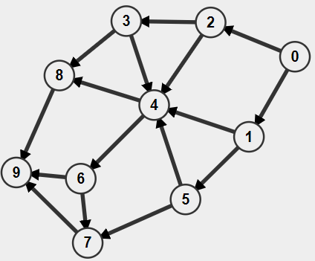
DFS
Print the lexicographically largest DFS of the following graph starting from 0

Slide 14
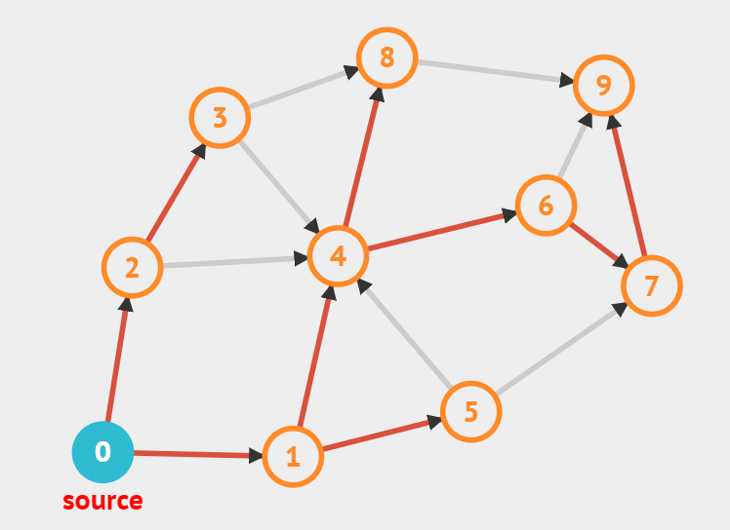
DFS
Print the lexicographically smallest DFS of the following graph
0 1 4 6 7 9 8 5 2 3

Slide 15
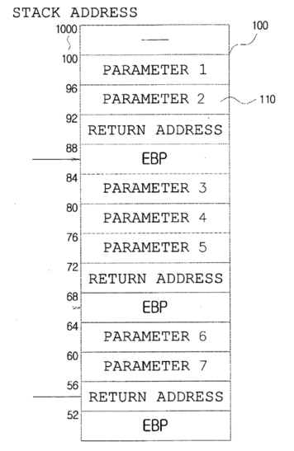
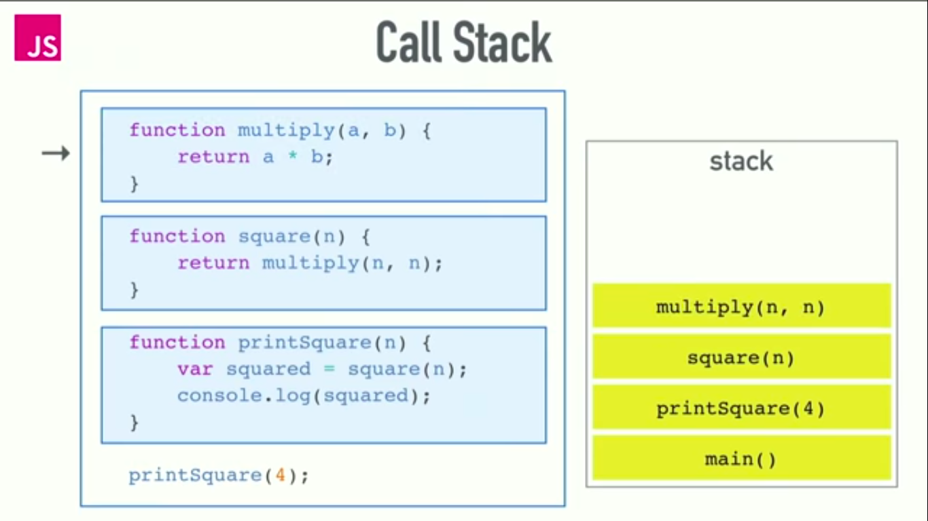
Call Stack

Slide 16
Call Stack

Slide 17
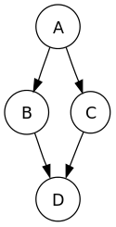
Traversal Order
A preordering is a list of the vertices in the order that they were first visited by the depth-first search algorithm.
E.g. A B D C / A C D B
A postordering is a list of the vertices in the order that they were last visited by the algorithm.
E.g. D B C A / D C B A
A reverse postordering is the reverse of a postordering, i.e. a list of the vertices in the opposite order of their last visit. Reverse postordering is not the same as preordering.
E.g A C B D / A B C D

Slide 18
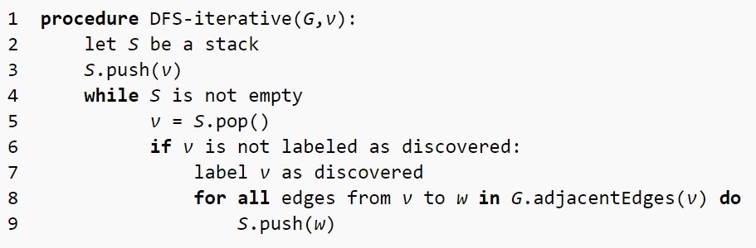
Depth First Search - DFS

Slide 19
DFS Iterative
Visited order?
A B D C
A C D B

Slide 20
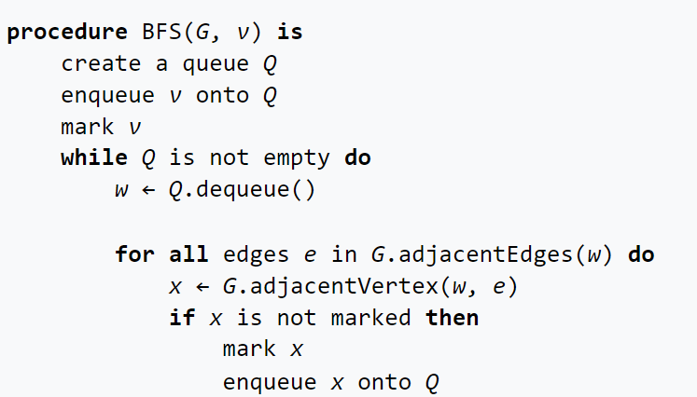
Breath First Search
A breadth-first search (BFS) is another technique for traversing a finite graph. BFS visits the sibling vertices before visiting the child vertices
A queue is used in the search process. This algorithm is often used to find the shortest path from one vertex to another.

Slide 22
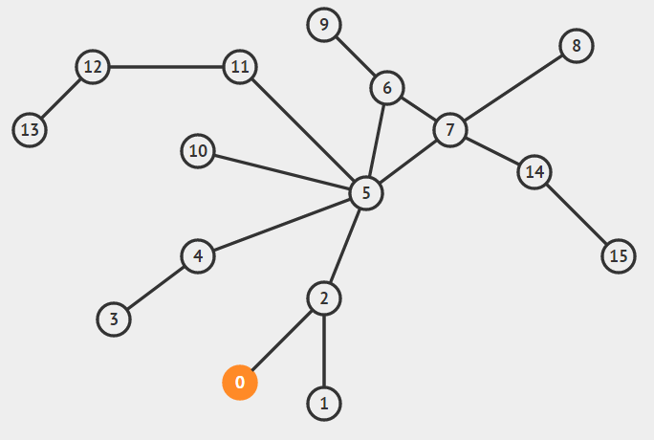
Breadth First Search

Slide 23
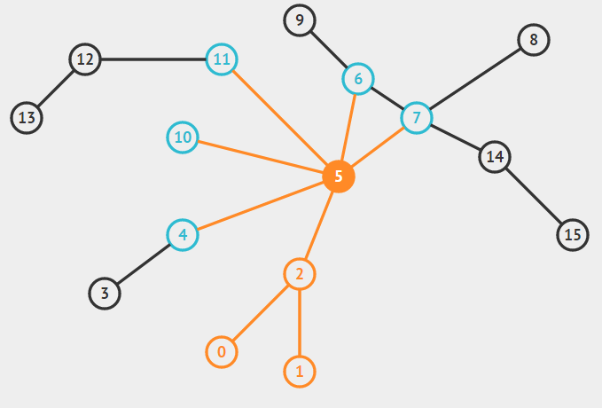

Slide 24
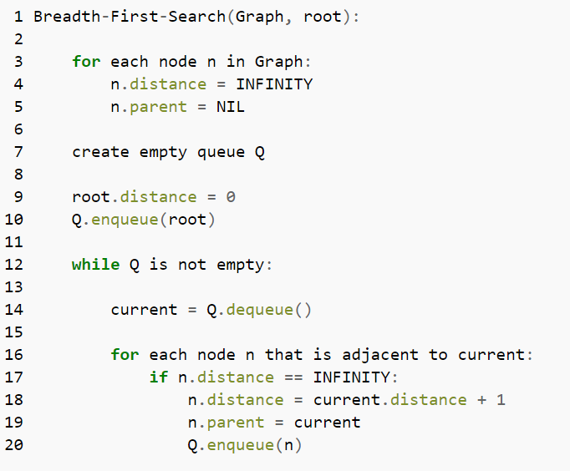
Breath First Search

Slide 25
Applications
https://www.spoj.com/EIUPROGR/problems/dis2_02/
DFS Directed Graph
DFS Undirected Graph
BFS Directed Graph
BFS Undirected Graph
Thành phần liên thông
Thành phần liên thông 2

Slide 26
Complexity
O(V+E)
Each vertex is only visited once due to the fact that DFS will only recursively explore a vertex u if status[u] = unvisited — O(V)
Every time a vertex is visited, all its k neighbors are explored and therefore after all vertices are visited, we have examined all E edges — (O(E) as the total number of neighbors of each vertex equals to E).

Slide 27
Backtracking
Backtracking is a general algorithm for finding all (or some) solutions to some computational problems, notably constraint satisfaction problems, that incrementally builds candidates to the solutions, and abandons each partial candidate c ("backtracks") as soon as it determines that c cannot possibly be completed to a valid solution.

Slide 28
Ref:
https://en.wikipedia.org/wiki/Depth-first_search
https://en.wikipedia.org/wiki/Breadth-first_search
https://en.wikipedia.org/wiki/Backtracking
http://visualgo.net/dfsbfs.html

